Slide 1

DriverPass System Analysis
Adam Gomez
Notes:
[No speaker notes required for this slide.]

Slide 2

System Requirements
Functional Requirements:
- Students can schedule, cancel, and reschedule driving lessons.
- Students can take online practice tests and view results.
Nonfunctional Requirements:
- The system must be available 99.5% of the time.
- All communication must be encrypted using SSL/TLS.
Notes:
These are the main requirements of the DriverPass system. Functionally, it allows students to book lessons and take tests. Nonfunctionally, it focuses on security, reliability, and accessibility so users can access it from any device with minimal downtime.

Slide 3
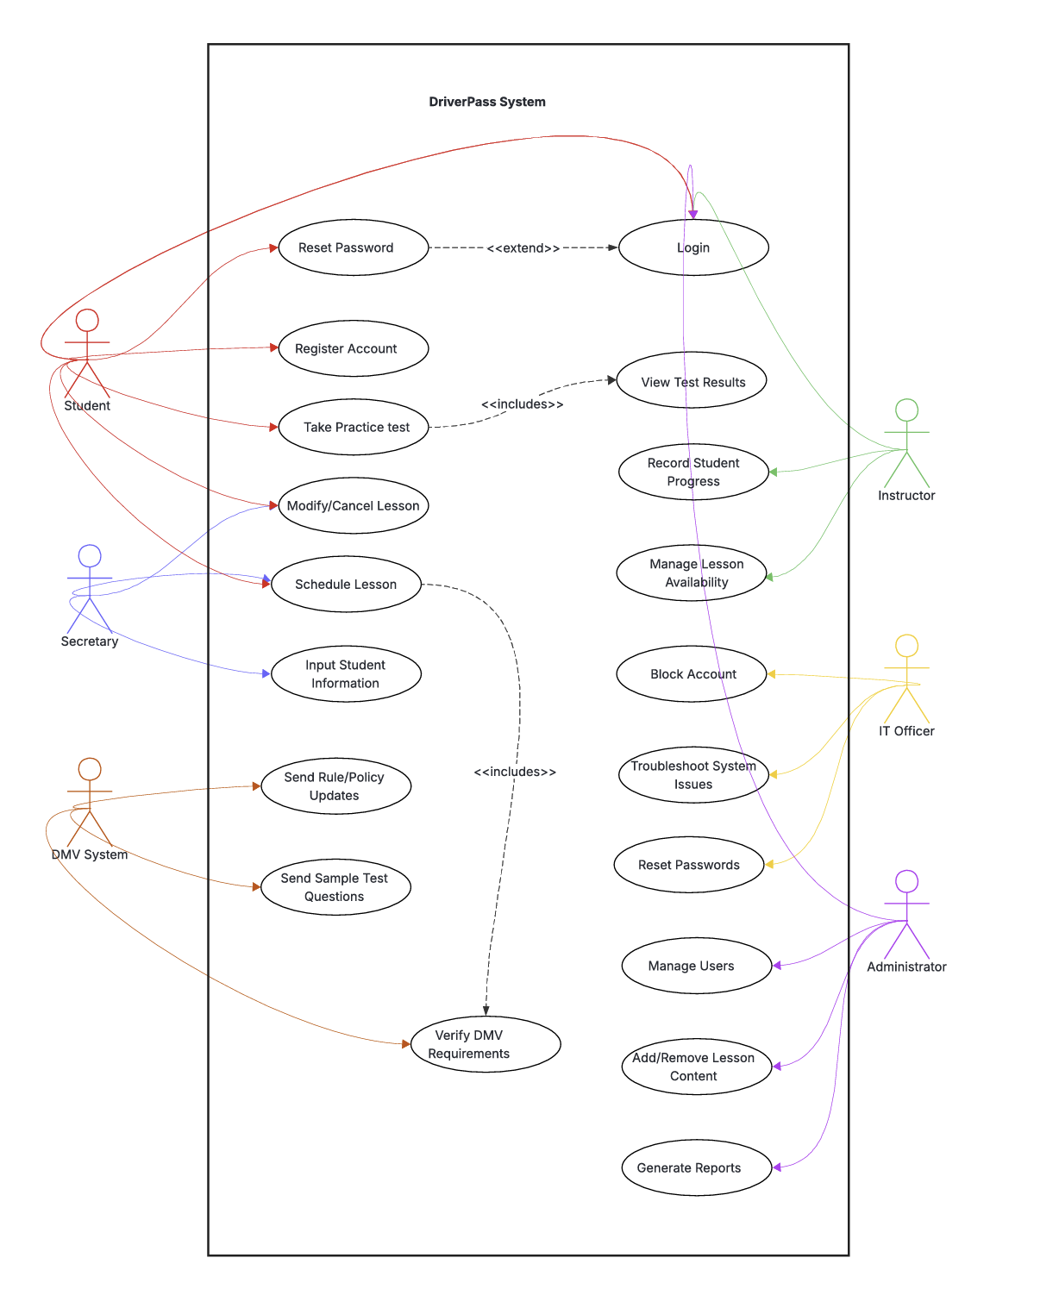
Use Case Diagram
Notes:
This use case diagram shows how students, instructors, and administrators interact with the system. Students can schedule lessons and take tests, instructors can manage availability, and admins can manage users and system settings.

Slide 4
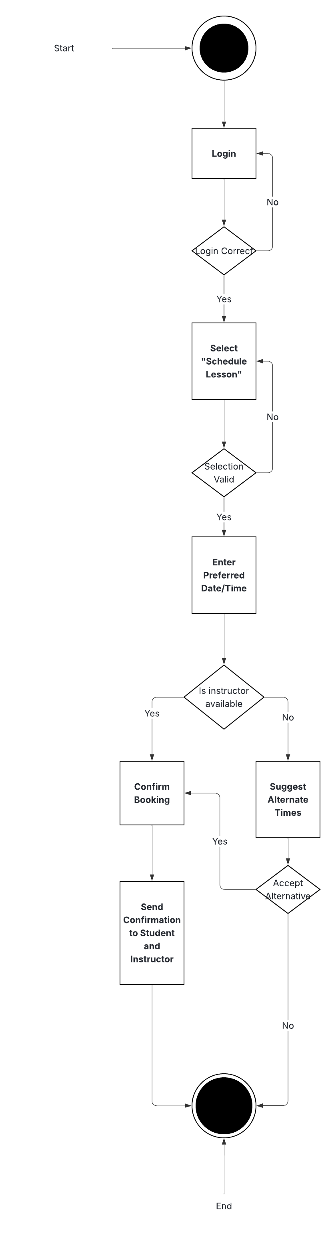
Activity Diagram
Notes:
This activity diagram illustrates the step-by-step flow for a student scheduling a lesson. It includes login, selecting a date and instructor, checking availability, confirming the lesson, and receiving notifications.

Slide 5
Security
- SSL/TLS encryption for all data in transit
- Encrypted database for data at rest
- Role-based access control for students, instructors, and admins
- Regular backups and audit logs
- Protection against SQL injection, XSS, and CSRF attacks
Notes:
Security is central to DriverPass. We protect user data through encryption, role-based access control, and regular auditing. The system prevents unauthorized access and ensures sensitive information like test scores and schedules remain secure.

Slide 6
System Limitations
- Requires reliable internet connection
- Instructor availability may limit scheduling flexibility
- Dependent on accurate data entry by users
- May require periodic maintenance or updates
Notes:
Like any web-based system, DriverPass depends on a stable internet connection and up-to-date data from instructors and students. Maintenance periods will occasionally limit access, but we’ve designed the system to minimize downtime.

